Slide 1
Evaluating a Digital Experience
EXSM 3929: Module 4

Slide 2
Learning Outcomes
What is the purpose of this module?
Create a process for manually auditing a webpage for basic accessibility
Use automated testing to evaluate a webpage or website
Practice manual accessibility testing, and compare with automated tests
Explain the importance of user testing for digital accessibility

Slide 3
Assignment Prompt
Assignment 2: Manual and Automated Accessibility Testing
Try to use a website without a mouse
Should you be able to access every feature easily?
How easy should accessibility reports be to read?
Assignment is available for download on eClass

Slide 4
Module Resources

Slide 5
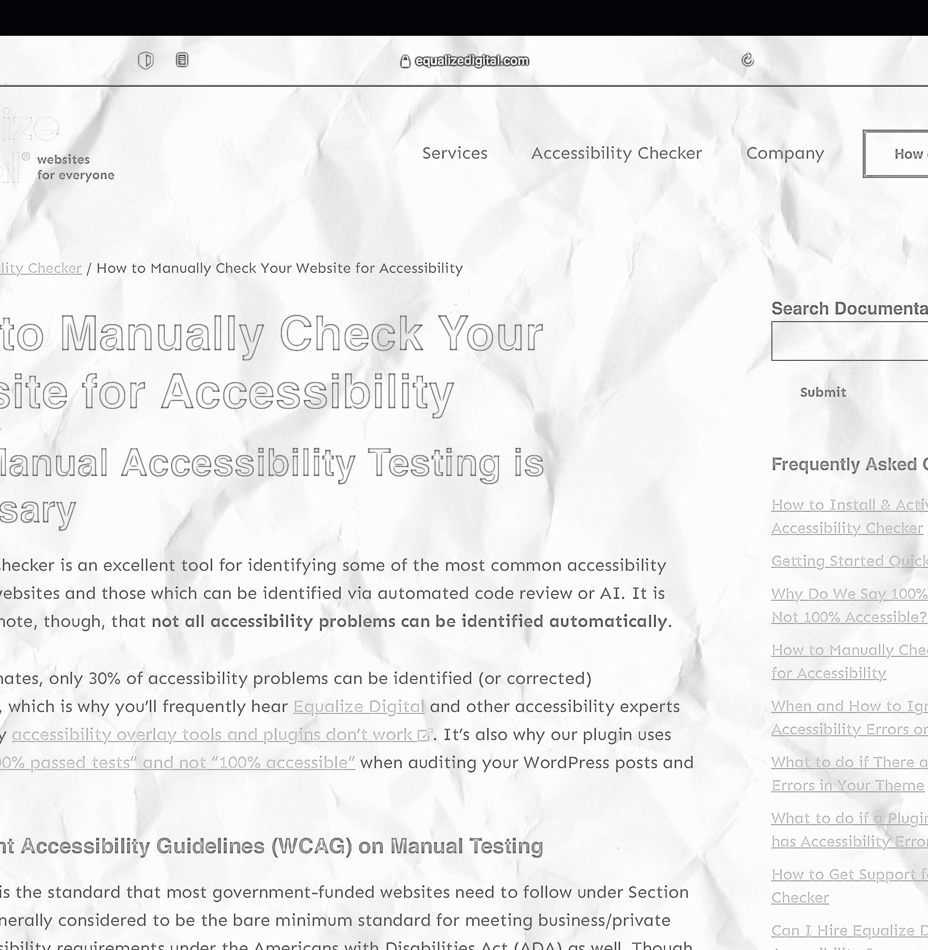
How to Manually Check Your Website for Accessibility
Equalize Digital. (2021). equalizedigital.com

Slide 6
“By some estimates, only 30% of accessibility problems can be identified (or corrected) automatically…”
- Equalize Digital, (n.d.)

Slide 7
How to test manually:
Create a plan
Start by testing keyboard navigation
Test your website with screen readers
Check embedded media and linked content for accessibility

Slide 8
Your Thoughts
Consider the following questions for our group discussion
Why is manual accessibility testing important?
What is the difference between manual testing and user testing?
Whose job is it to run manual tests (designers, developers, others)?

Slide 9
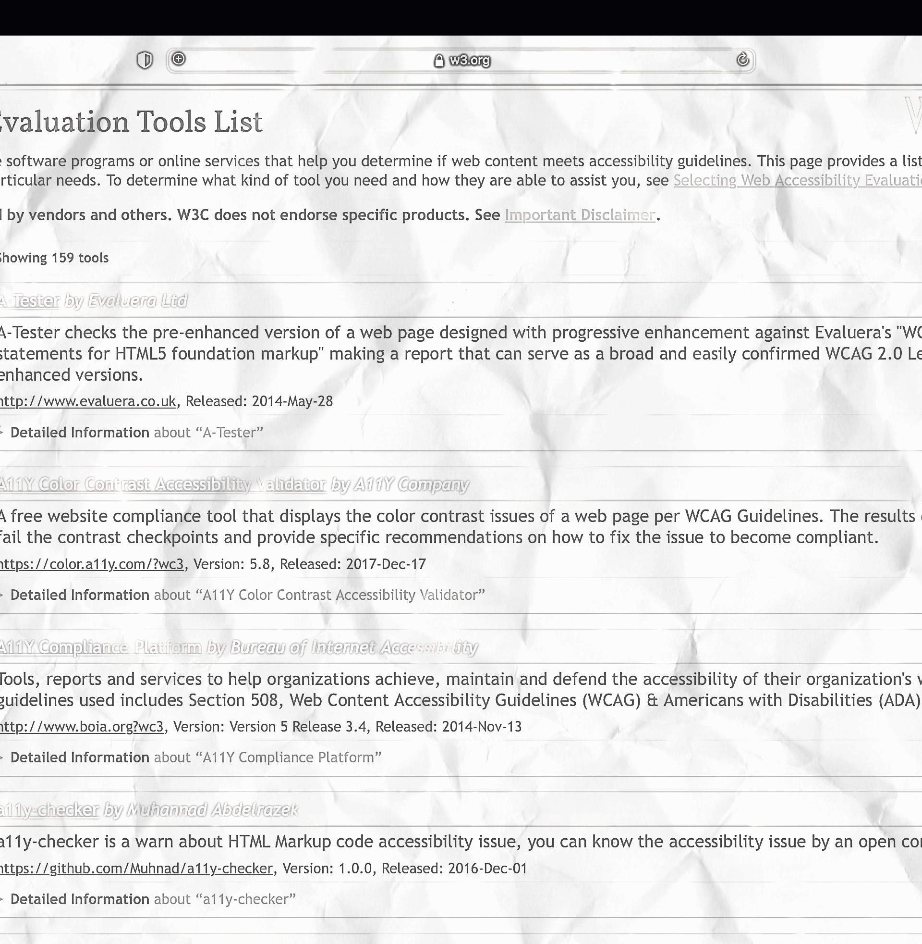
Web Accessibility Evaluation Tools List
W3. (n.d.). w3.org

Slide 10
“Web accessibility evaluation tools are software programs or online services that help you determine if web content meets accessibility guidelines”
- W3, (n.d.)

Slide 11
Tools are not evaluated for accuracy
Use the filters to narrow your search
Use multiple tools and compare results among similar tests
Think about the results before making recommendations

Slide 12
Your Thoughts
Consider the following questions for our group discussion
How many tools did you try (without being prompted)?
Did you find any tools particularly useful?
Did you generate any unexpected results?

Slide 13
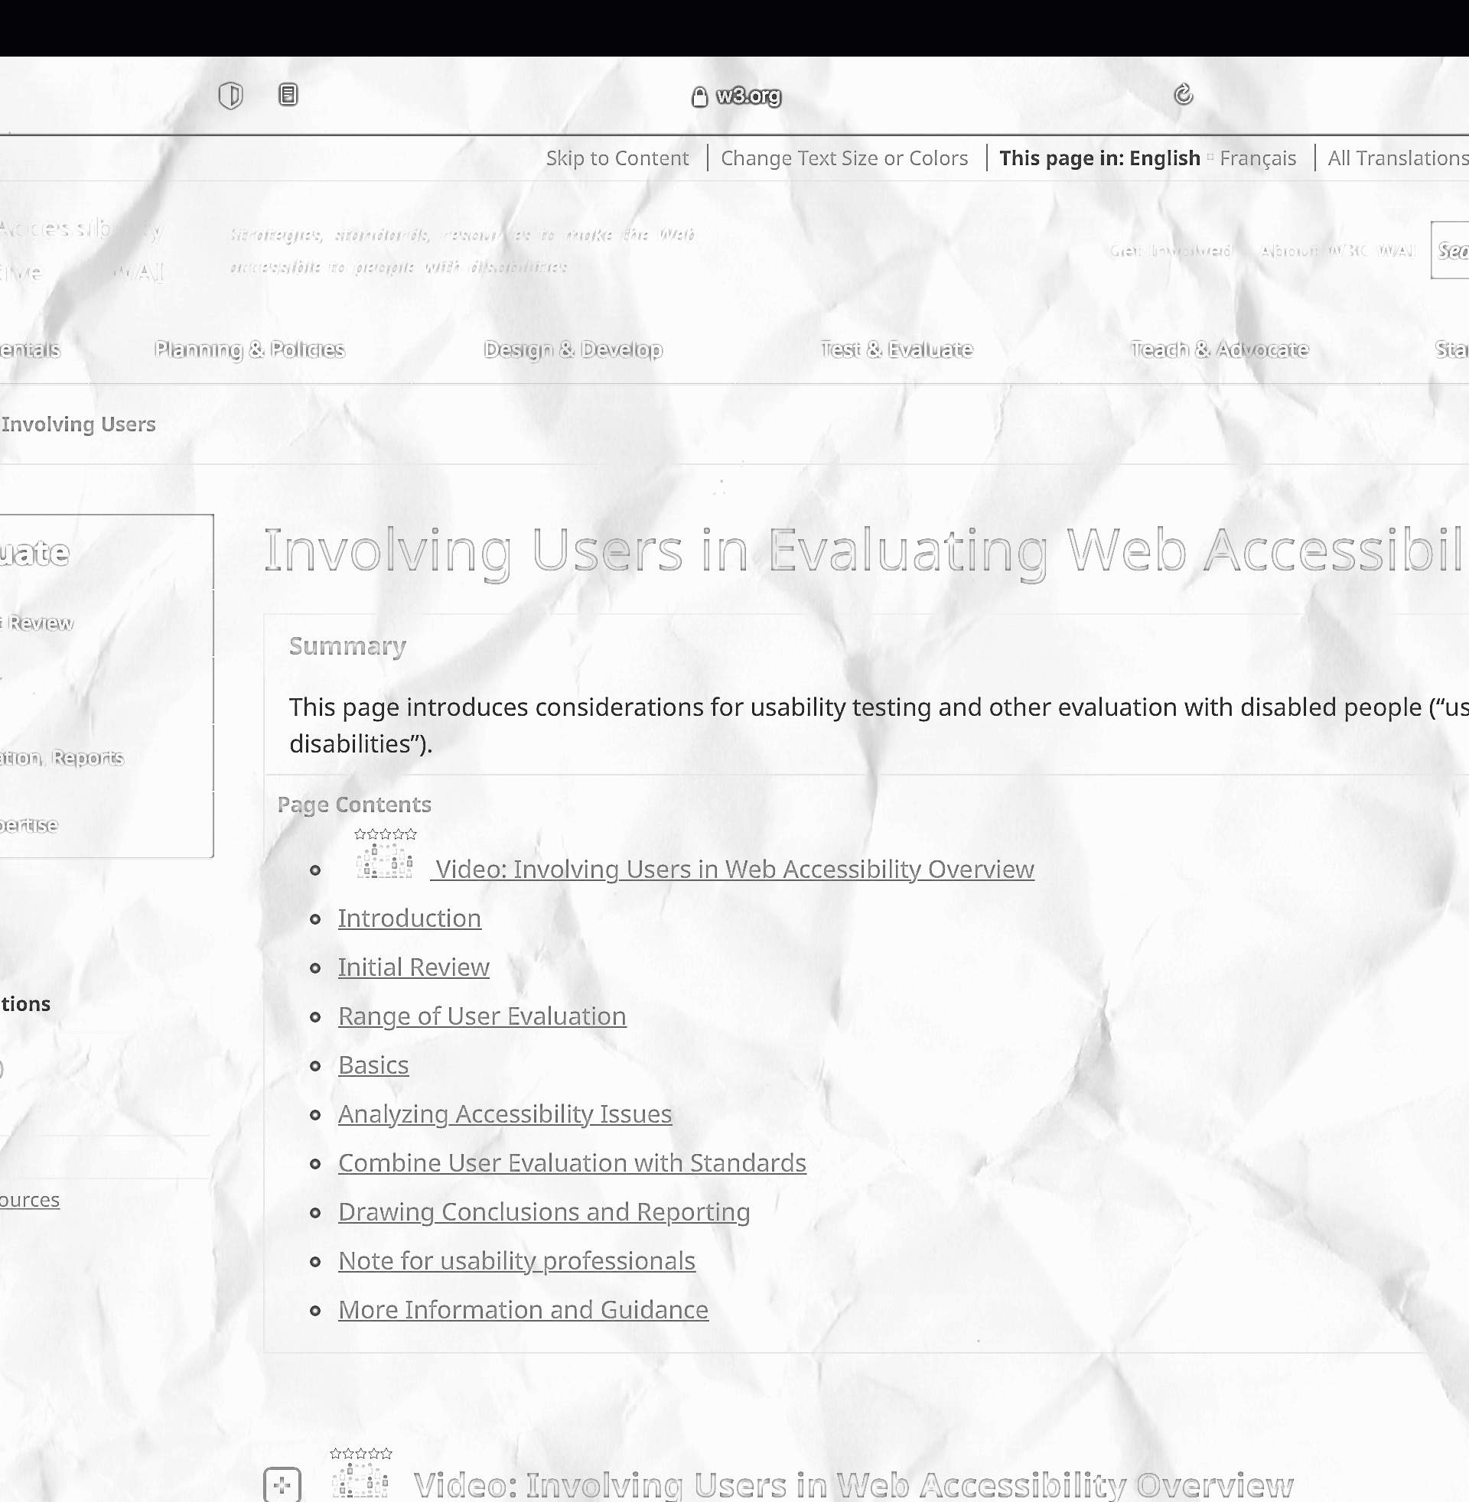
Involving Users in Evaluating Web Accessibility
W3. (2021). W3.org

Slide 14
“Evaluating with users with disabilities and with older users identifies usability issues that are not discovered by conformance evaluation alone.”
- W3, (2021)

Slide 15
Focus the evaluation with users on potential areas of concern
Informal evaluations vs formal usability testing
Discuss the accessibility issues with them
Be careful drawing conclusions from limited evaluations or studies

Slide 16
Your Thoughts
Consider the following questions for our group discussion
How would you change your testing criteria to include disabled users?
Why is it difficult to draw conclusions from single instance user testing?
How could you make this whole process easier?

Slide 17
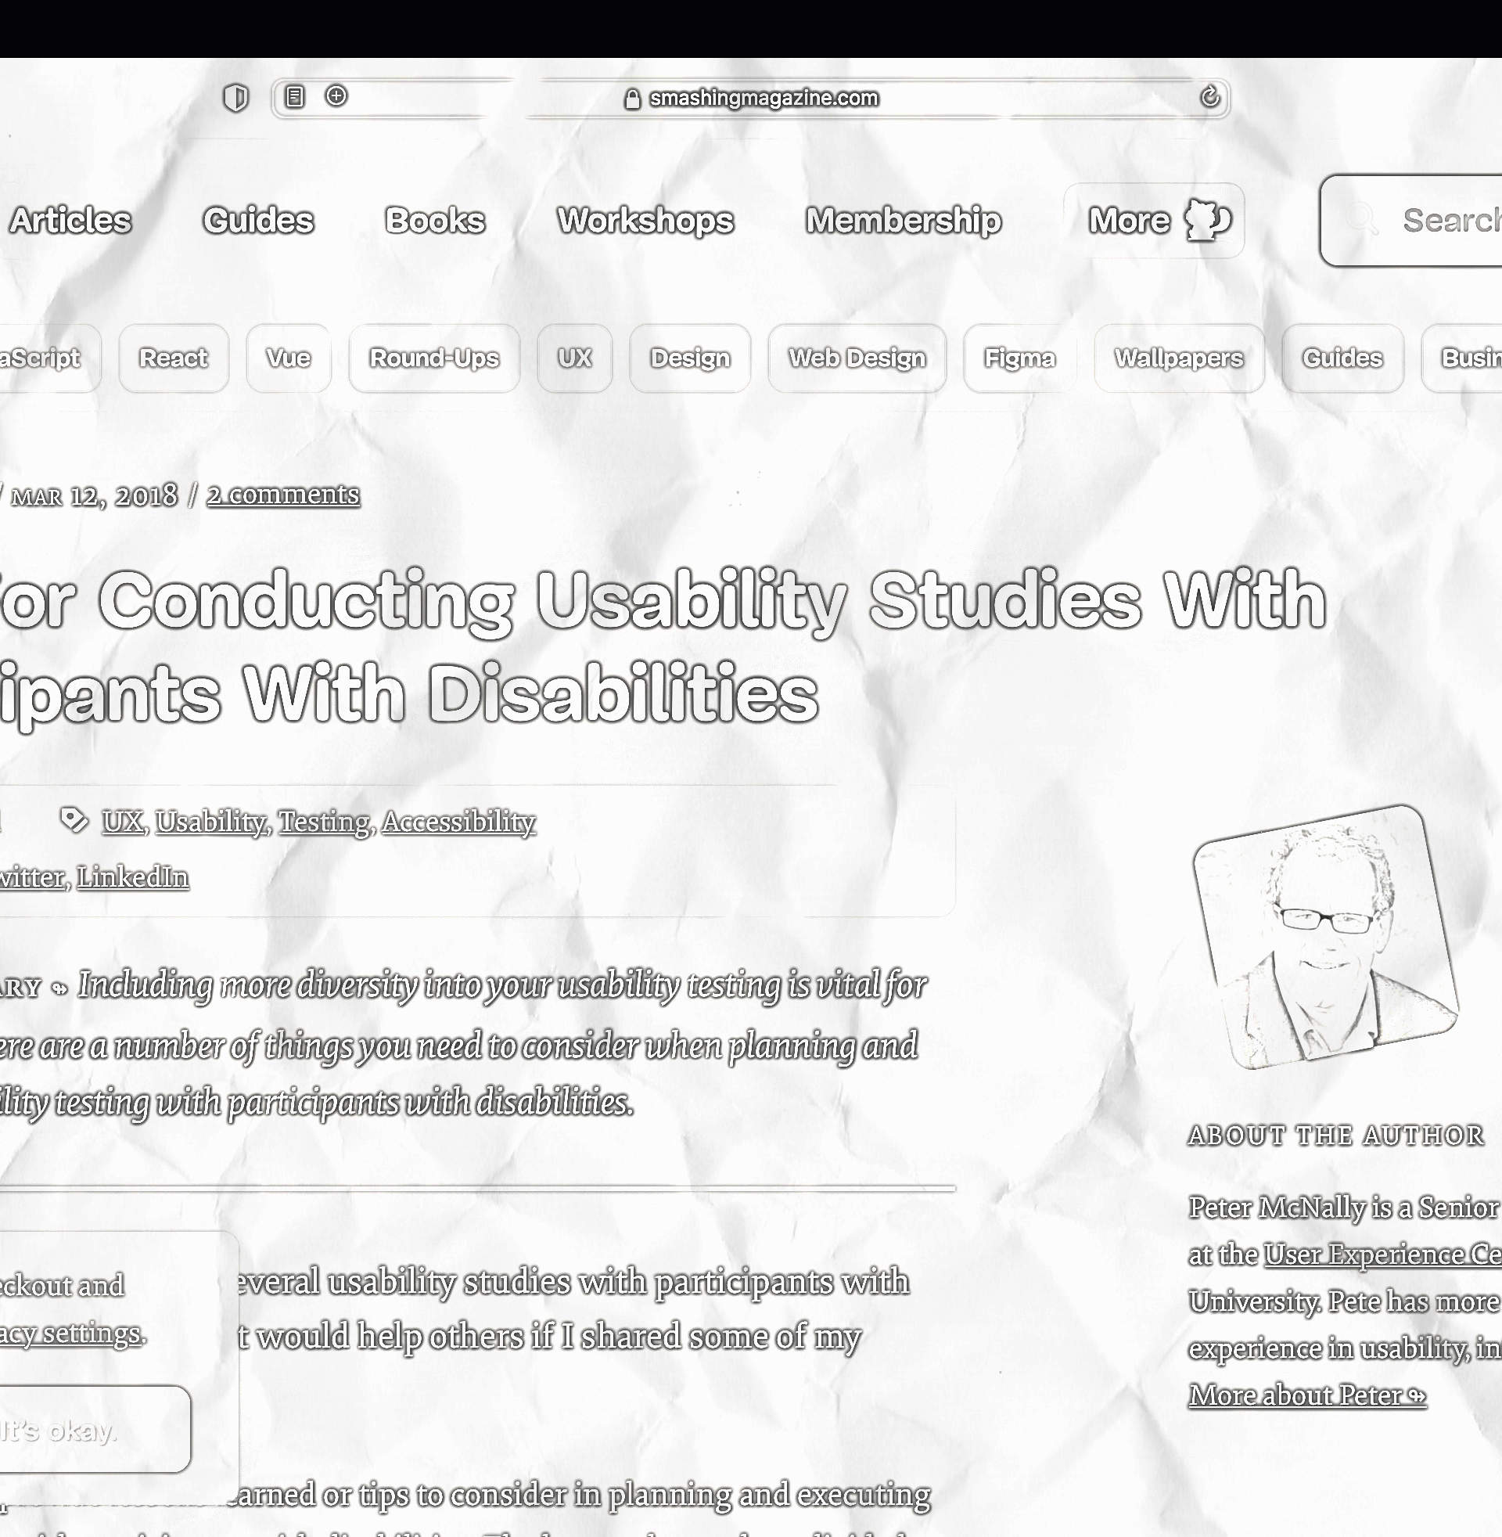
Tips for Conducting Usability Studies with Participants with Disabilities
McNaly, P. (2018). smashing magazine.com

Slide 18
“Even if a site follows the accessibility guidelines and is technically accessible, users may not be able to accomplish their goals on the site.”
- McNally, P., (2018)

Slide 19
Ensure a baseline level of accessibility before usability testing
Always have a backup plan
Be flexible with your requirements - work with the ability of the user
Make special considerations for testing with users who have impaired visibility, motor function, or cognitive abilities

Slide 20
Your Thoughts
Consider the following questions for our group discussion
At what stage would you recommend user testing for accessibility?
How would you approach recruitment for user testing?
What challenges can you imagine with remote accessibility testing?

